Slide 1
BOSCH RESEARCH
Goal : combine multiple perspective view to Panorama
Louison Lu

Slide 2


Dataset
Waymo End-to-End Driving Dataset ：
8 camera：
3 Front :front、front-left、front-right
2 Side : side-left、side-right
3 Back :back、back-left、back-right
rolling shutter timing
cons：
rolling shutter will cause jelly effect
Argoverse 2 Sensor Dataset
7 個 cameras
3 Front :front、front-left、front-right
2 Side : side-left、side-right
2 Back : back-left、back-right
Global shutter

Slide 3
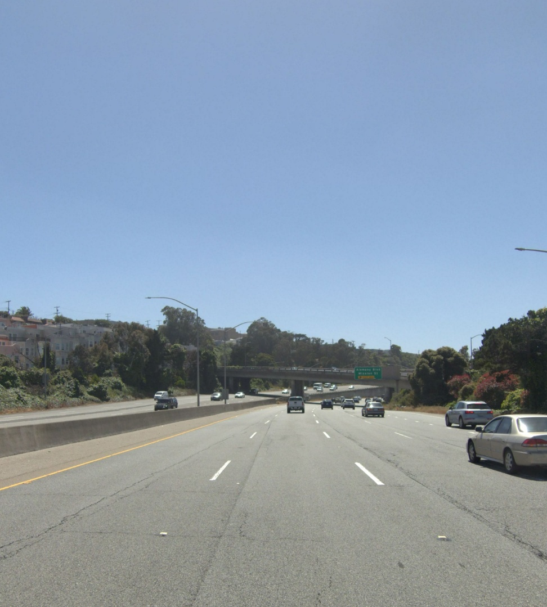
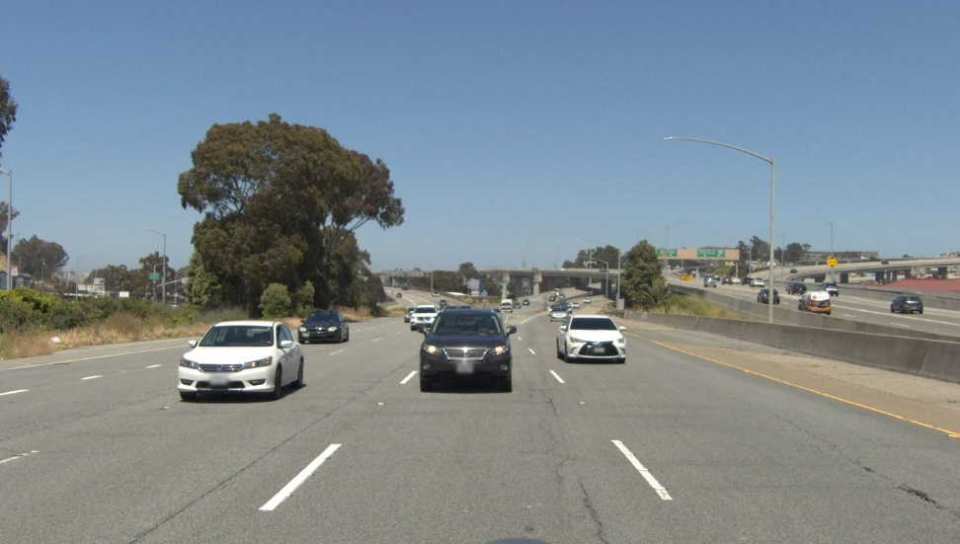
Dataset
Not same size
Front and Side camara is 972x1079（Straight），the back is 972x587 / 972x551 / 972x587（Horizontal）。Each camera around 47 degree（each frame will overlap 1~2 degree）
Each camera have their intrinsic / extrinsic
Parallax => no too bad

Slide 4
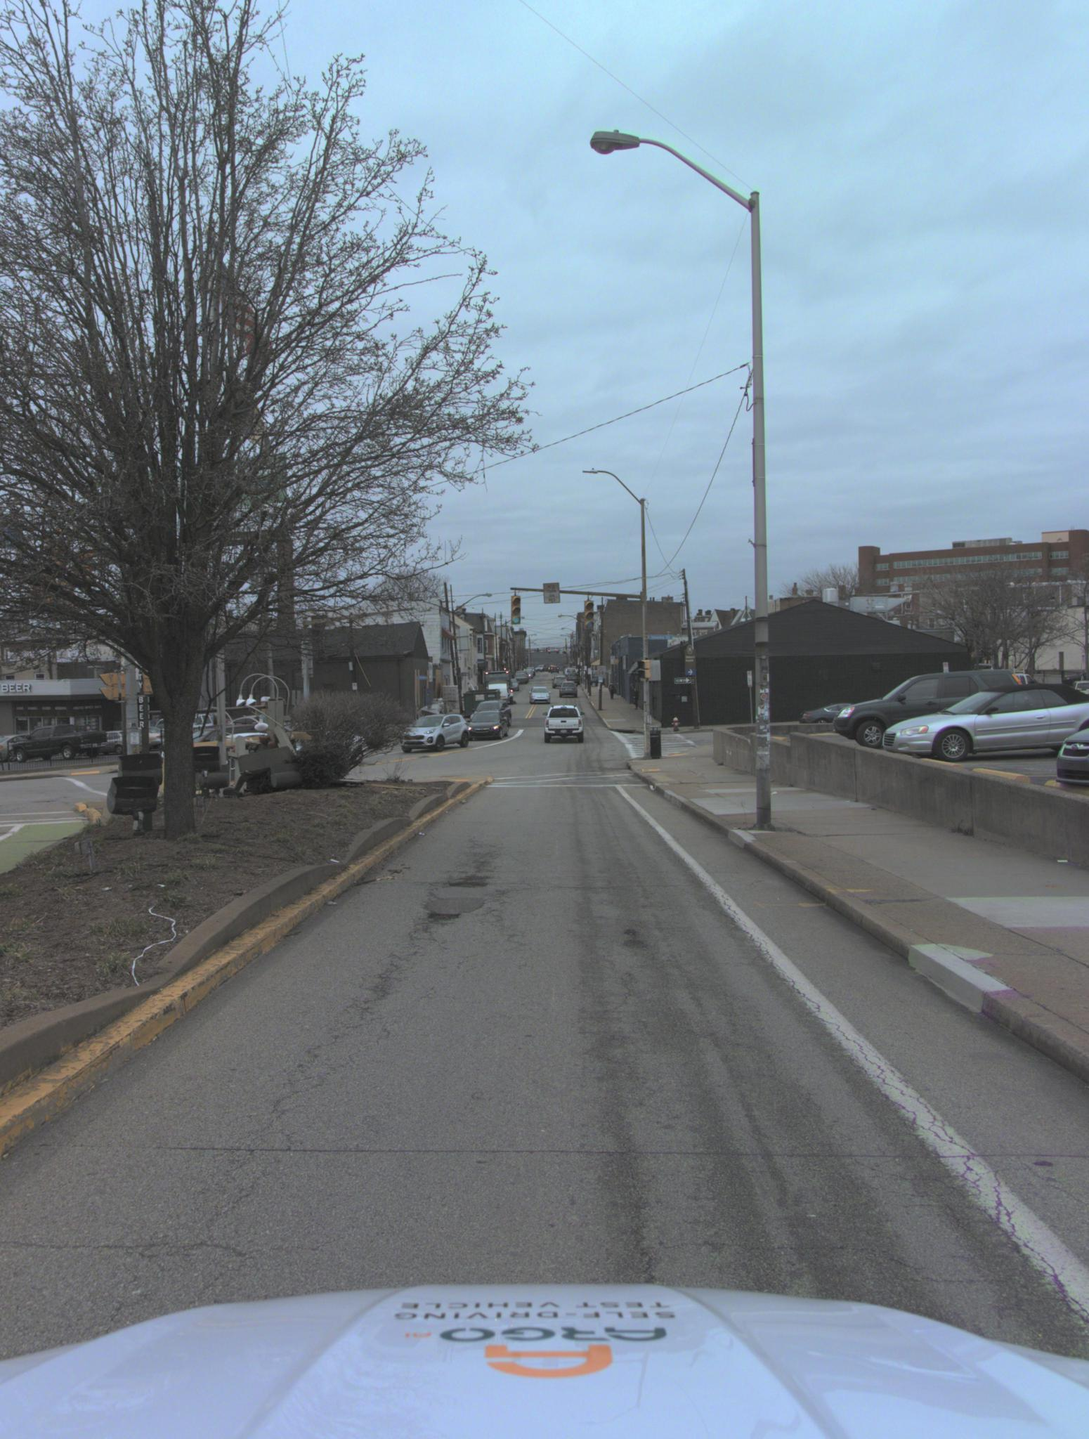
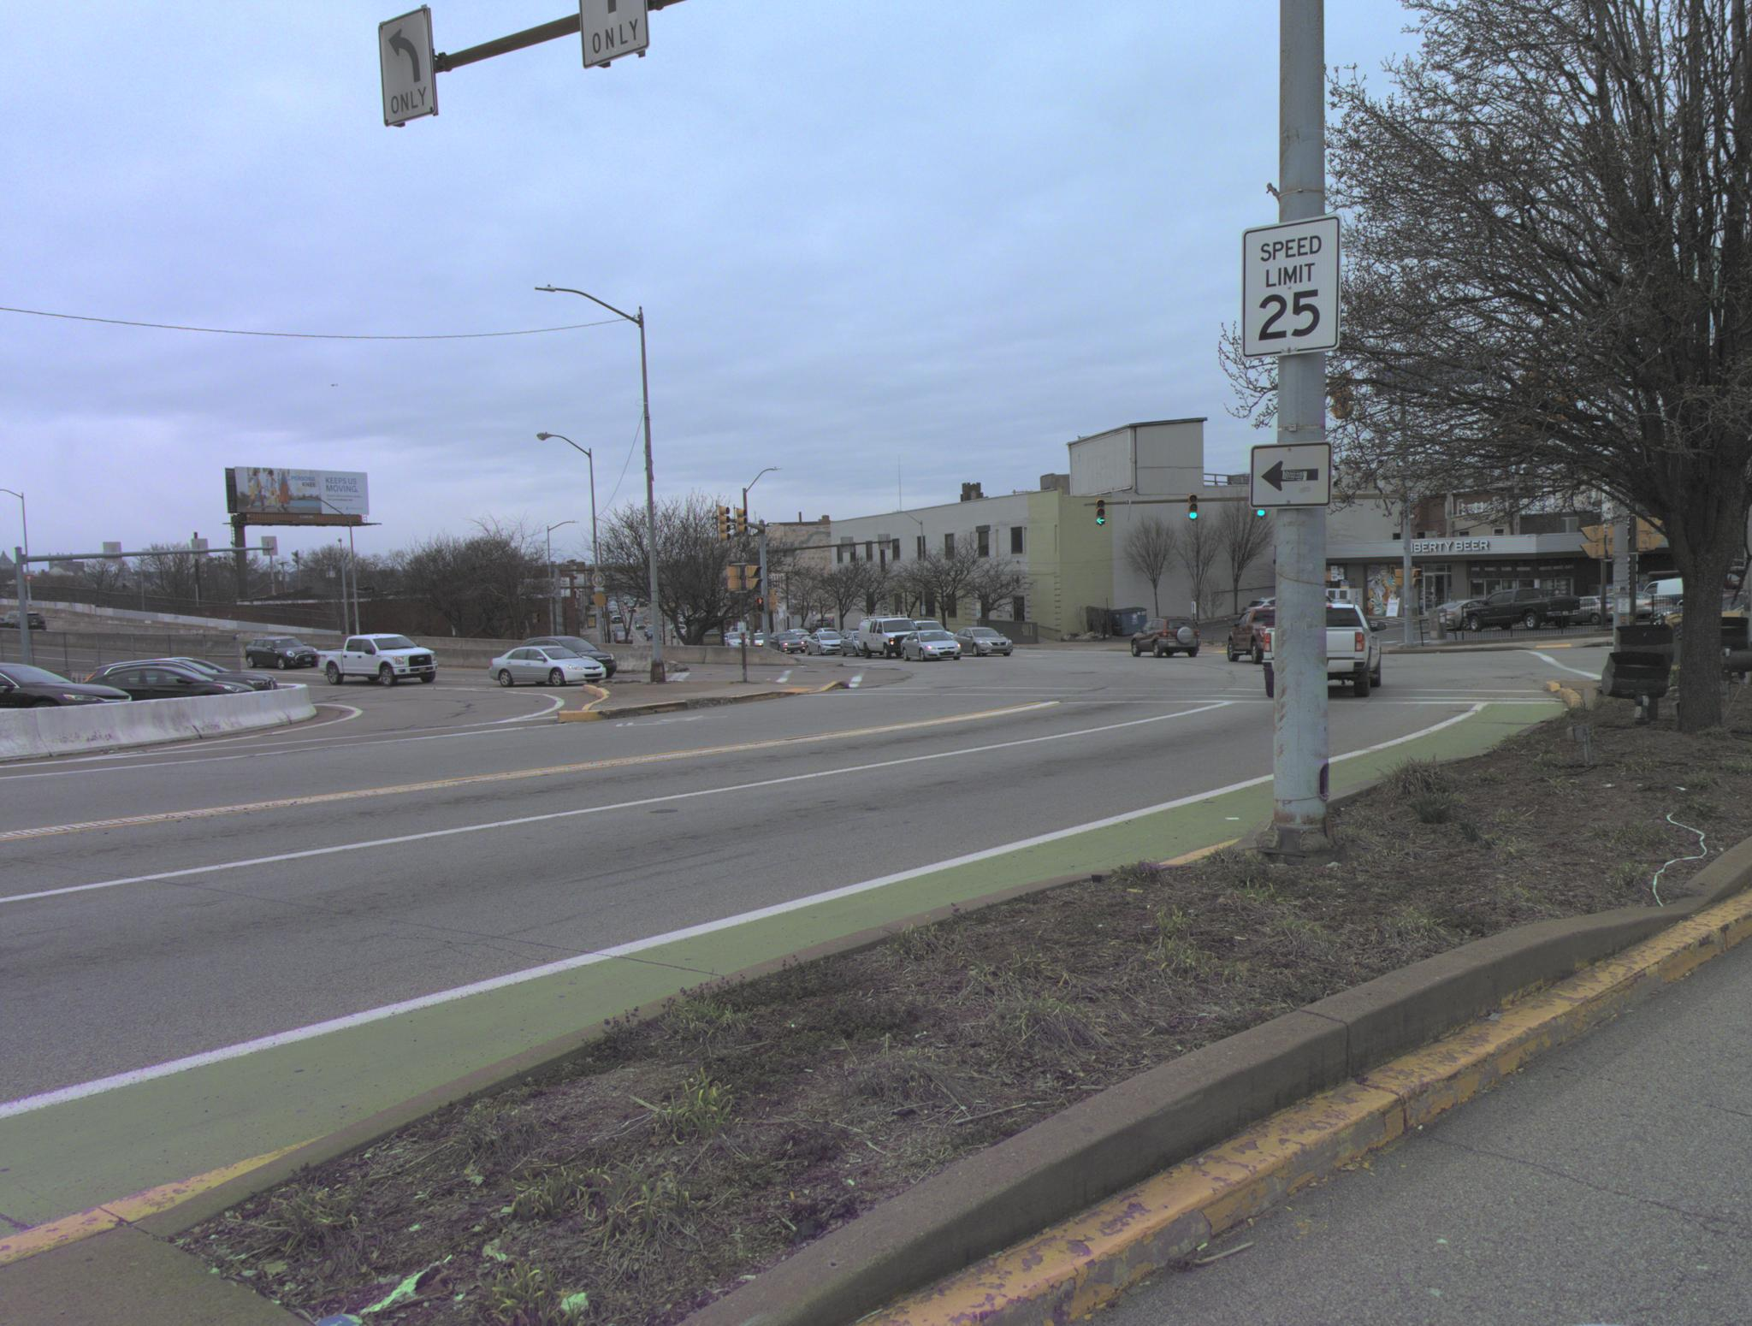
Dataset
Only front is 1550 x 2048（Straight），the other is 2048 x 1550（Horizontal）。Each camera around 47 degree and 60 degree（each frame will overlap 8~9 degree）
Each camera have their intrinsic / extrinsic
Parallax => Bad.
The AV2 cameras are more downward-facing. more sensitive to road markings

Slide 5
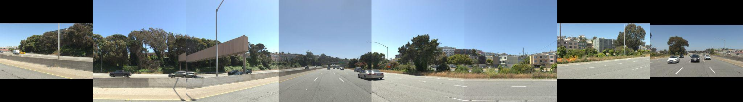
Original

Slide 6
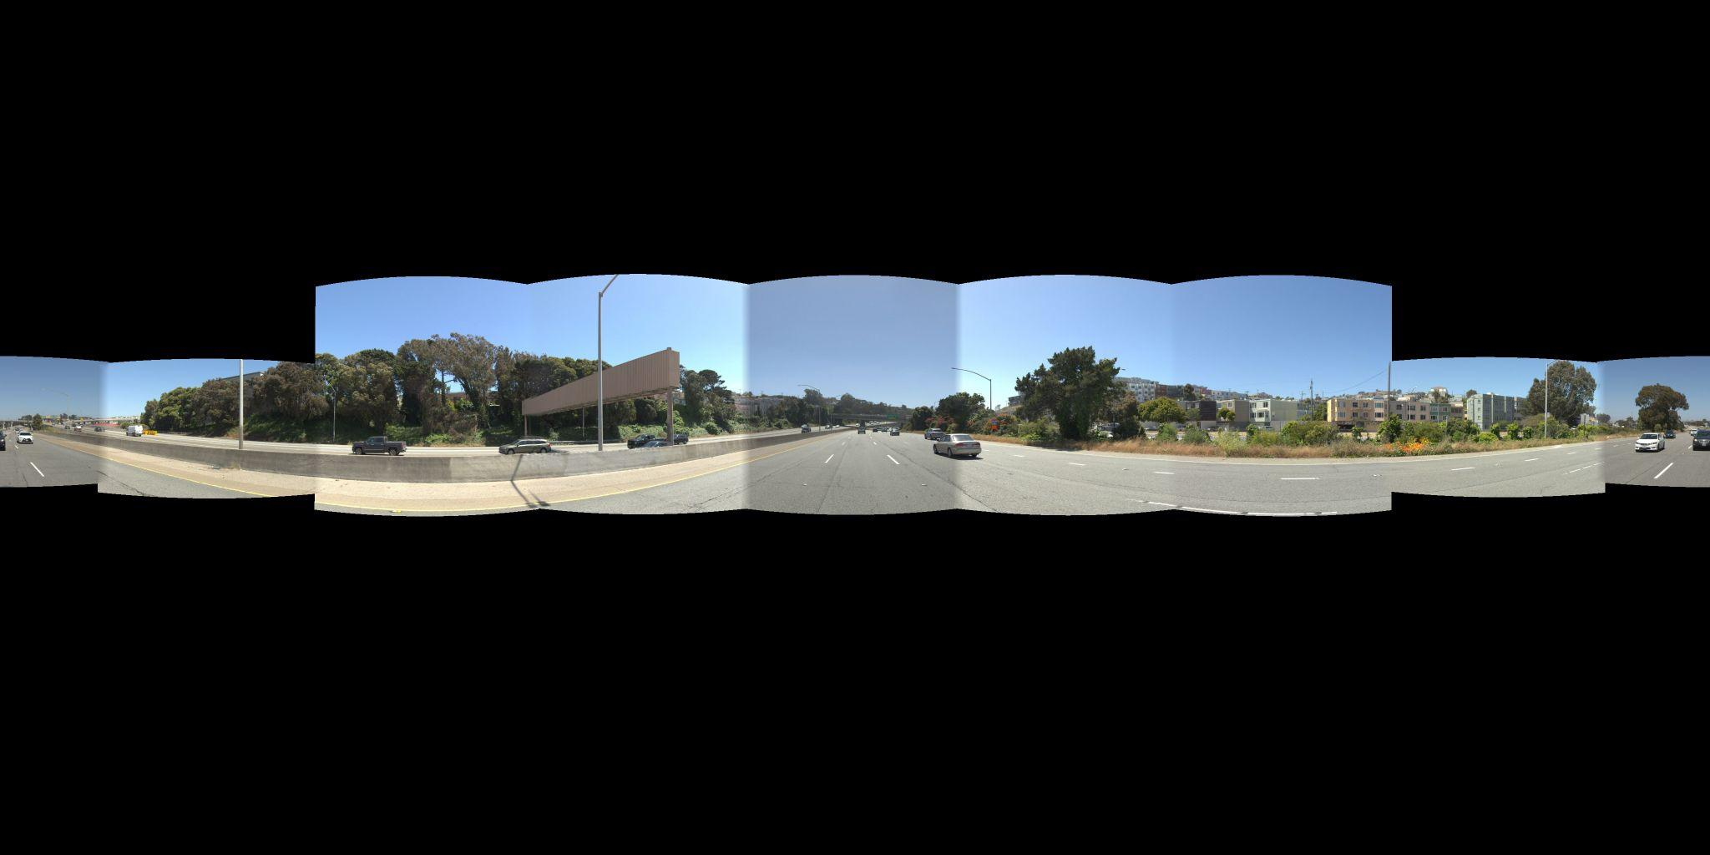
After (geometry-based)
Size : 4096 x 2048
Ratio : 2:1 ERP
covered pixels: 23.11%

Slide 7
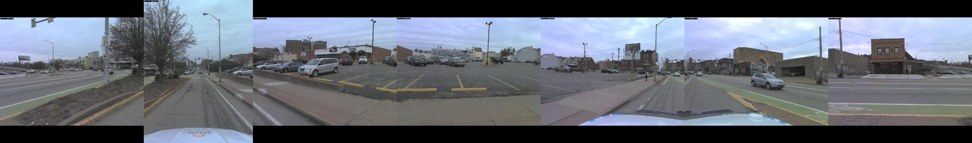
Original

Slide 8
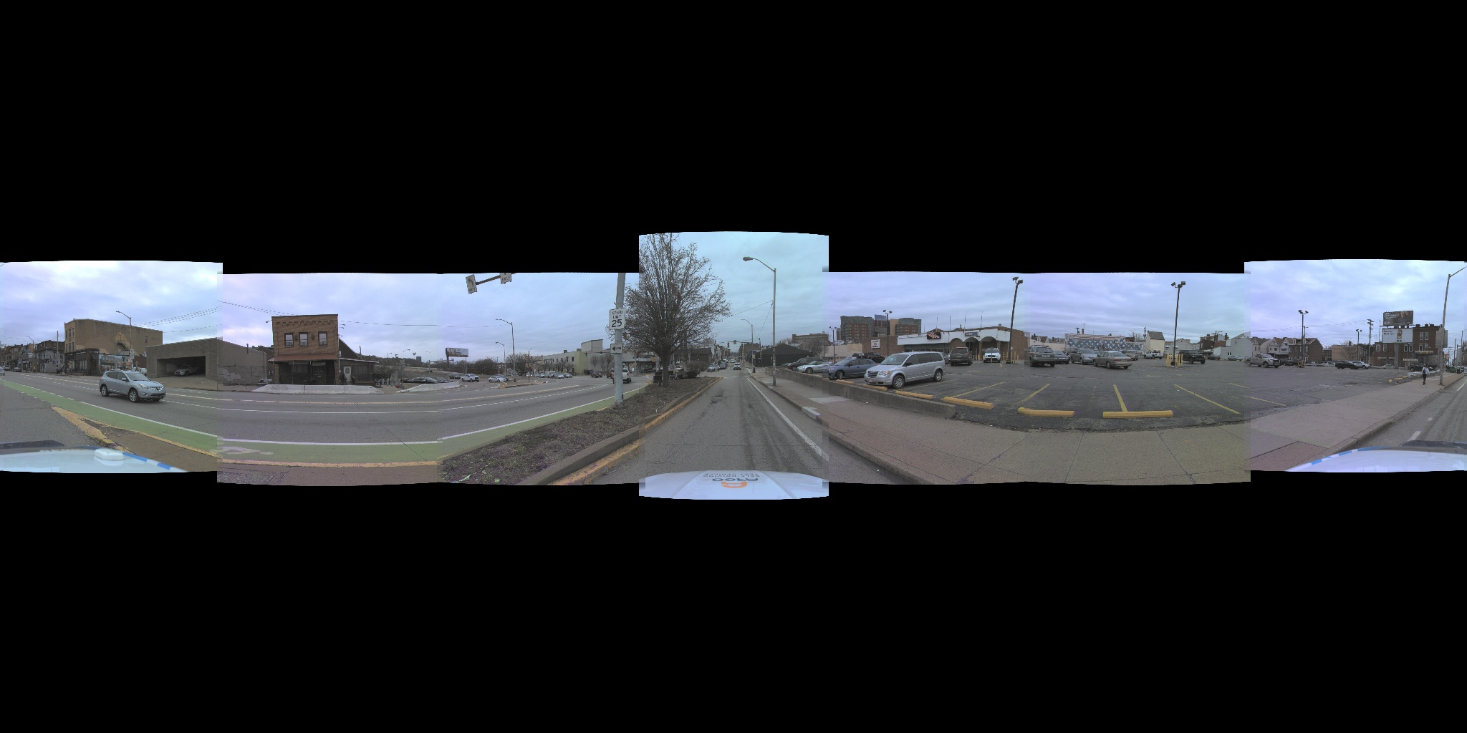
After(geometry-based)
Size : 2048 x 1024
Ratio : 2:1 ERP
covered pixels: 32.41%

Slide 9
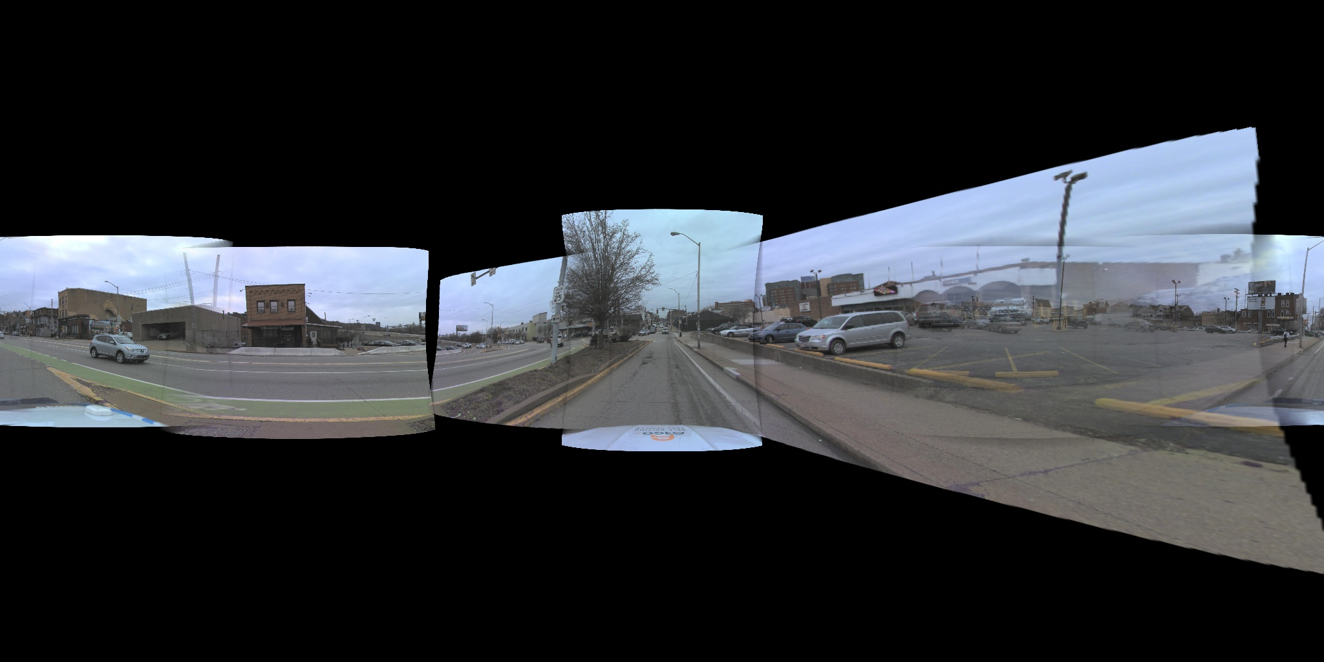
After(feature point) ORB feature detection
Size : 2048 x 1024
Ratio : 2:1 ERP
covered pixels: 40.49%

Slide 10
Dataset
用相機 calibration，把 8 張圖重新投影到 360° panorama。
每張圖都有自己的 intrinsic / extrinsic
overlap 區做平滑過渡
最簡單的 blending => 在 overlap 左邊比較相信 A 圖，右邊比較相信 B 圖
multiband blending=> 它不是整張圖都用同一種混合策略，大尺度亮度差慢慢融合 小尺度細節盡量保留

Slide 11
Theory
Each experiment Goal
Level 1：Geometry feasibility | 能不能形成合理的 360° panorama？
Level 2：Visual quality | seam、ghosting、parallax 是否可接受？
Level 3：Video consistency | Y連續影格是否穩定？
Level 4：Downstream usefulness | stitched 360° video 拿去做 Cosmos Transfer training，是否真的有幫助？

Slide 12
AI-based stitching
You can delete this slide when you’re done editing the presentation
FONTS | To view this template correctly in PowerPoint, download and install the fonts we used
USED AND ALTERNATIVE RESOURCES | An assortment of graphic resources that are suitable for use in this presentation
THANKS SLIDE | You must keep it so that proper credits for our design are given
COLORS | All the colors used in this presentation
ICONS AND INFOGRAPHIC RESOURCES | These can be used in the template, and their size and color can be edited
EDITABLE PRESENTATION THEME | You can edit the master slides easily. For more info, click here
For more info: Slidesgo | Blog | FAQs
You can visit our sister projects: Freepik | Flaticon | Storyset | Wepik | Videvo

Slide 13
Method
方法一，純 calibration 投影 | 多相機是否能基本重建 360 視野？
方法二，加入 depth | 能否改善 parallax 與近物錯位？
方法三，feature stitch | 傳統拼接 baseline 會不會失敗？
方法四，固定角度切片 | 最粗糙 baseline 長什麼樣？

Slide 14
Dataset
Waymo End-to-End Driving Dataset 官方頁面寫的是：
相機資料是 10 Hz
Training：2,037 segments，每段 20 秒
Validation：479 segments，每段 20 秒
Testing：1,505 segments，每段 12 秒。
用Testing => 12 sec×10 frames/sec= 120 frames
Scenario duration: 15 seconds
Total number of scenarios: 1000
Average number of cuboids per frame: 75

